Slide 1
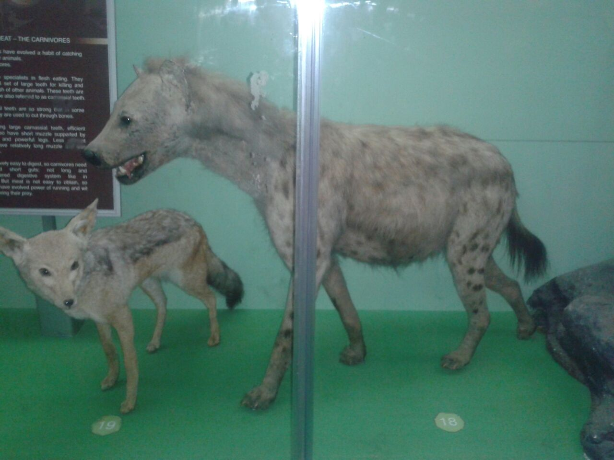
The laughing hyena
Kingdom –Animalia
Phylum –Chordata
Class - Mammalia
Order- Carnivora
Family - Hyaenidae
Genus - Crocuta
Species- Crocuta crocuta
Notes:
The organism is an adult hyena. The photo was obtained from the museum, the animal contains haploid reproductive gametes. This predator has keen sense of smell, sound and sight that aid in hunting.

Slide 2
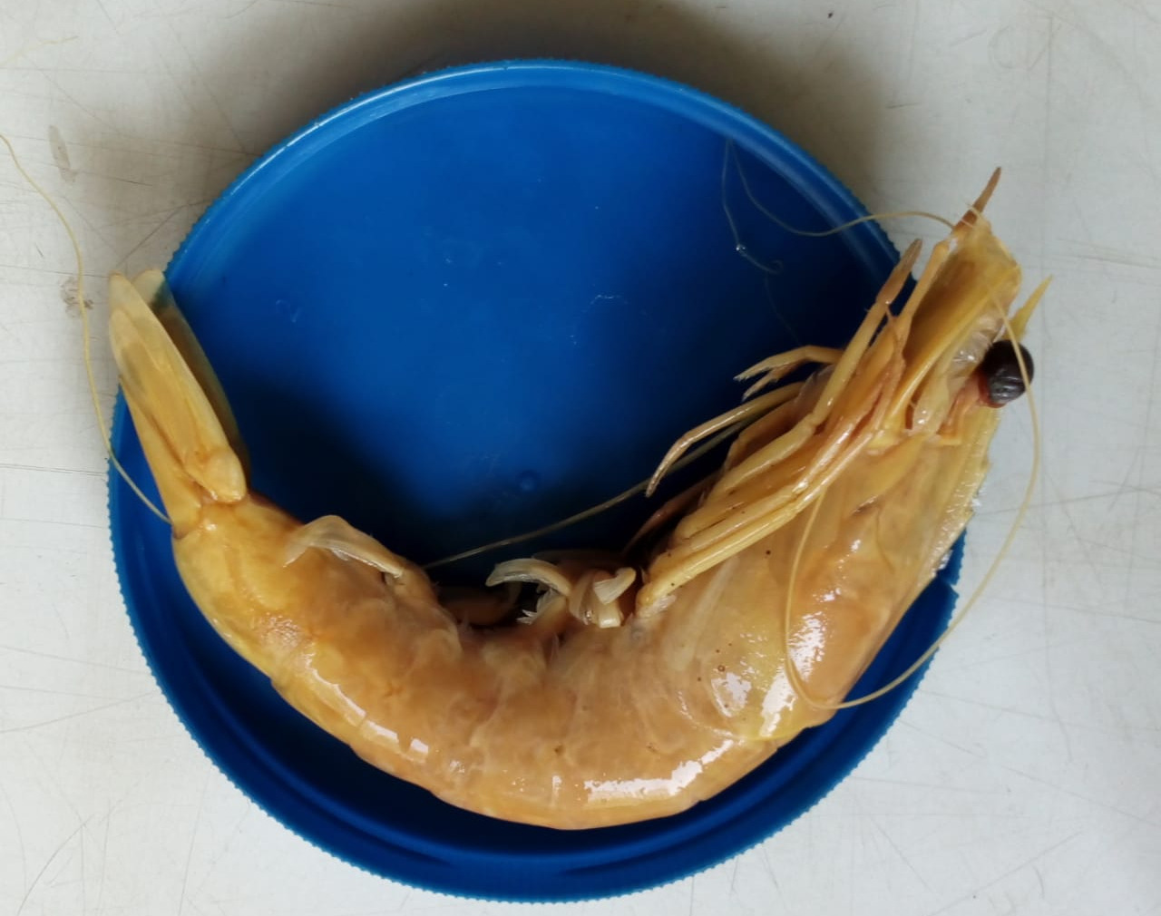
Gaint Tiger Prawn
Kingdom-Animalia
Phylum –Arthropoda
Class –Molacostraca
Order- Decapoda
Family –penaeiodea
Genus –penaeus
Species –Penaeus monodon
Notes:
The sample represents an adult prawn. Sexually mature prawn produce gametophyte. This organism undergoes molting that provides room for growth.

Slide 3
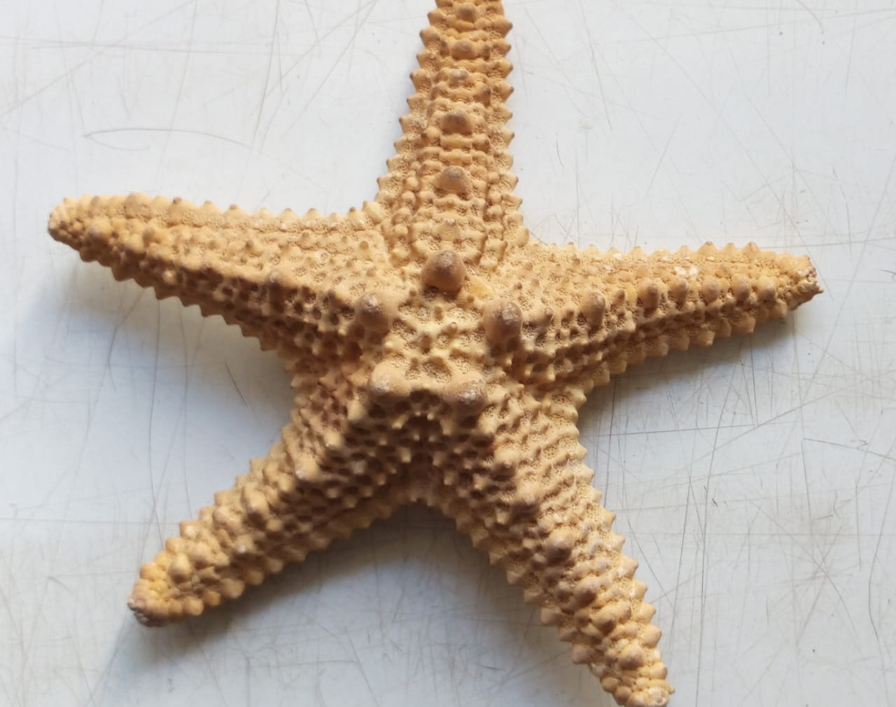
Sea star
Kingdom- Animalia
Phylum –Echinodermata
Class –Asteroidae
Order –Valvatida
Family- Oreasteridae
Genus- Pentaceraster
Species- Pentaceraster mammillatus
Notes:
The organism was found in the beach and it is an adult sea star it is covered with spines unlike fish that are covered with scales. The sea star has five arms and numerous tube feet for movement and aid in feeding. The sea star reproduce both sexually and asexually. The sea star has both diploid and haploid gametes.

Slide 4
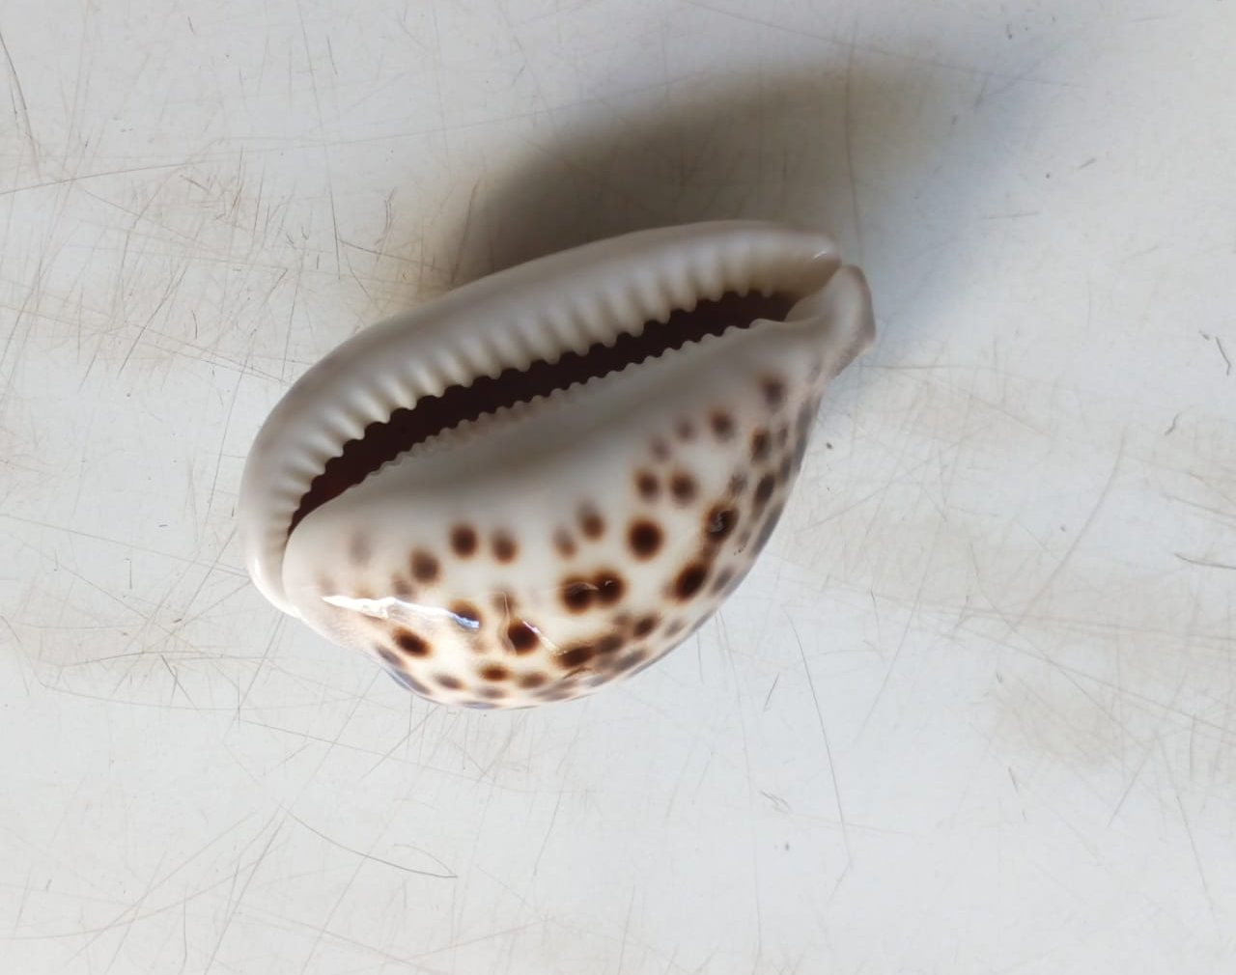
Tiger cowrie
Kingdom- Animalia
Phylum-Mollusca
Class- gastropoda
Order-littorinimorpha
Family-Cypraeidae
Genus-Cypraea
Species- Cypraea tigris
Notes:
Tiger cowrie are found in saline waters, they are known to feed on sponges and hydroids. Additionally, females same as male tend to be larger. After mating the female lays eggs and cover them with their foot this adaptation has made them successful gastropods. The tiger cowrie has 3 life cycles namely the larvae stage, callus building bulla sage and finally the adult stage. The gametes are haploid. The organism was obtained from an aquarium.

Slide 5
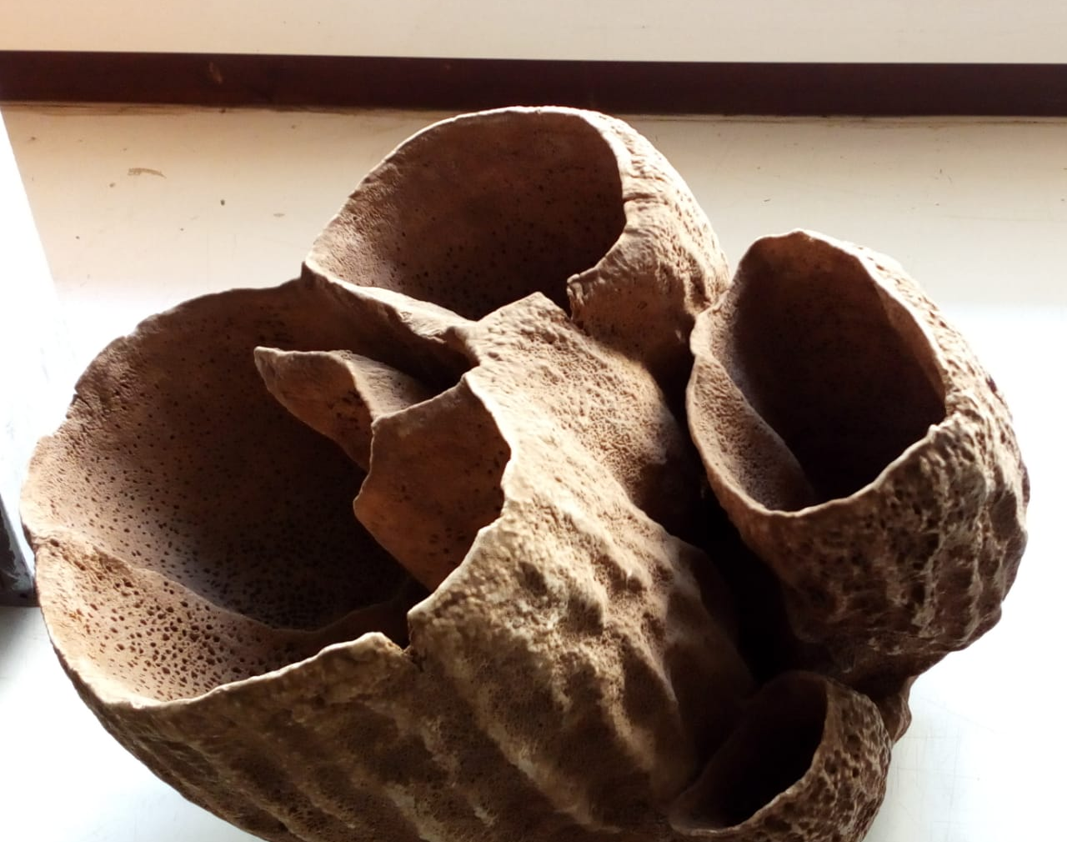
Kingdom- Animalia
Phylum-Porifera
Class -Demospongiae
Order-Hadromerida
Family- Clionaidae
Genus-Spheciospongia
Species- Spheciospongia excentrica
Notes:
This organism is a marine sponge, the openings of the organism are pore, asexual reproduction is by budding while sexual reproduction is through egg and sperm, the organism is asymmetrical. The has pore and canals for water passage.

Slide 6
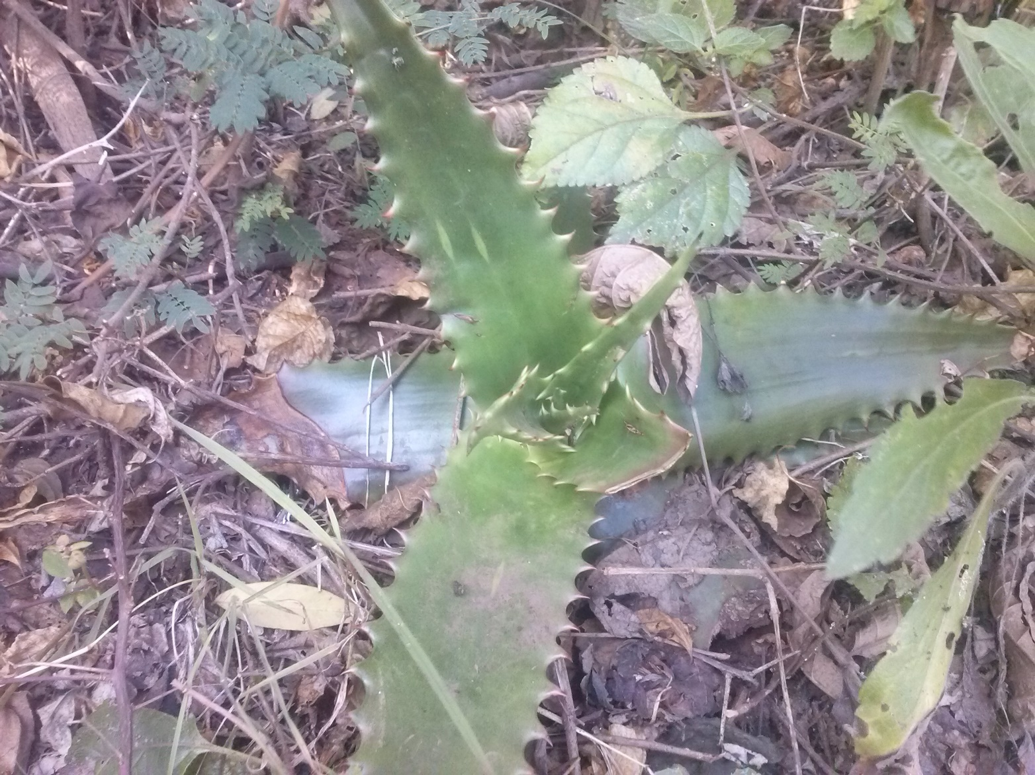
Aloe Vera
Kingdom-plantae
Division-Tracheophyta
Class-Magnoliopsida
Order-Aspciragales
Family-Xanthorrhoeacea
Genus- Aloe
Species- Aloe vulgaris
Notes:
The plant is adapted to area with low water concentration. The organism represents an adult plant. It has succulent fleshy leaves to hold water to sustain the plant during dry season. The plant reproduce by forming small offset at the base of the plant which eventually grow in a full plant.

Slide 7
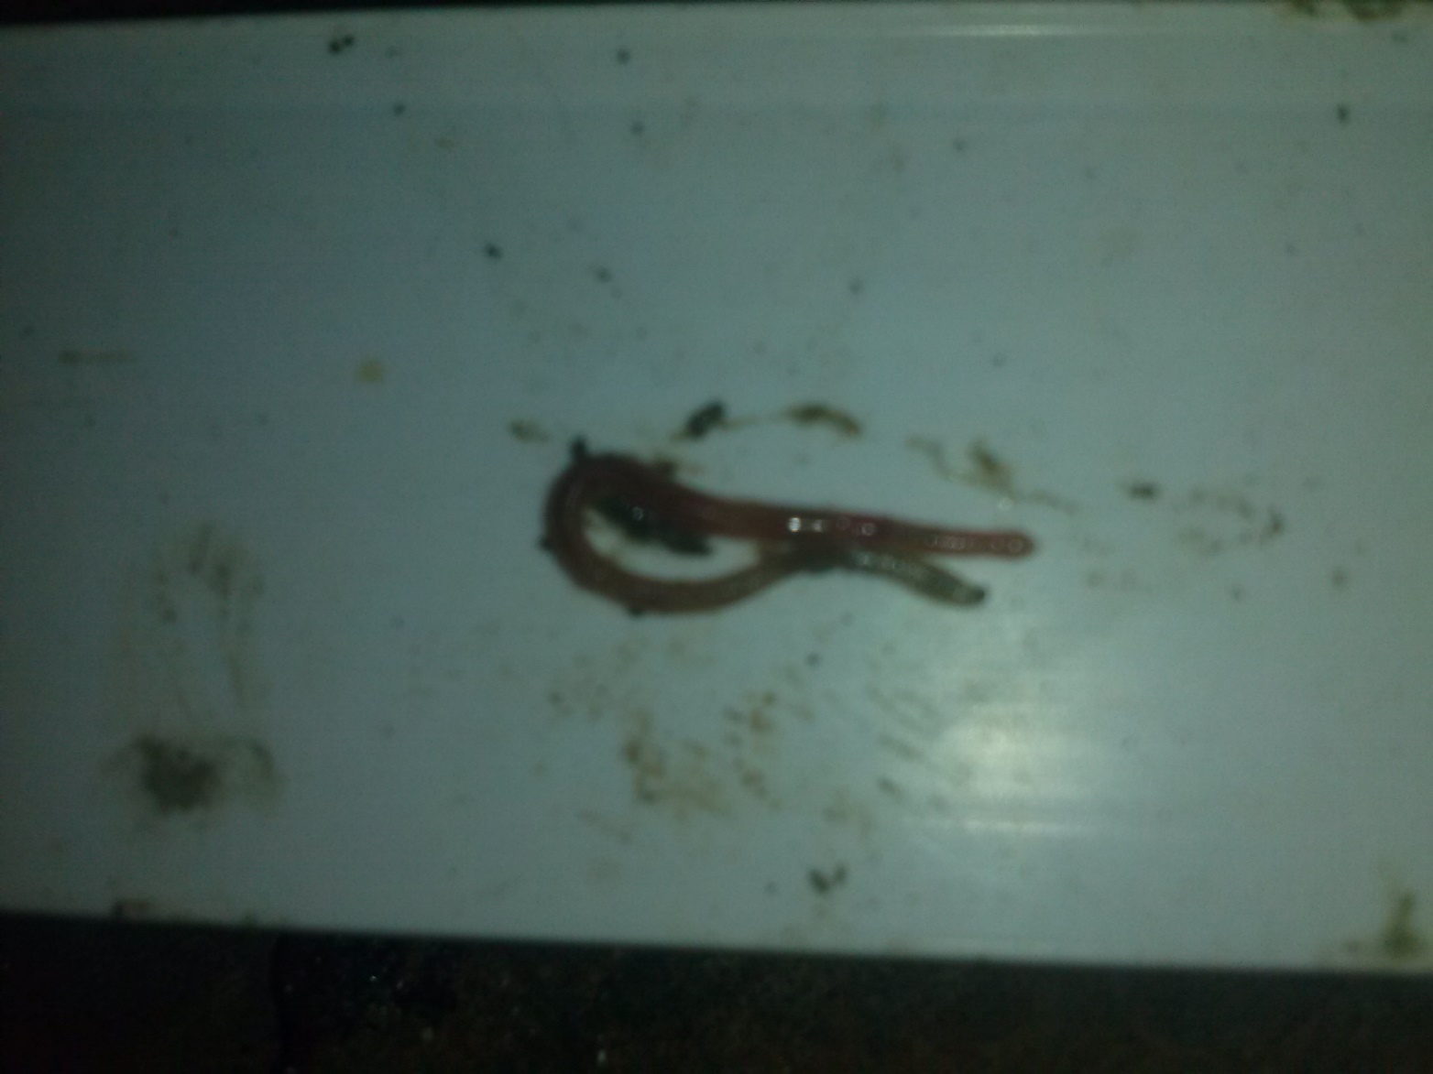
earthworm
Kingdom- Animalia
Phylum- Annelida
Class- Oligochaete
Order-Haplotaxida
Family- Lumbricidae
Genus-Lumbricus
Species- Lumbricus terrestris
Notes:
The earth worm are commonly found in moist gardens soils. Earthworms have streamlined bodies without arms or feet to allow them to live in narrow burrows underground and to move easily through the soil. Earthworms are hermaphrodite that is they contain both the male and female reproduction organs.

Slide 8
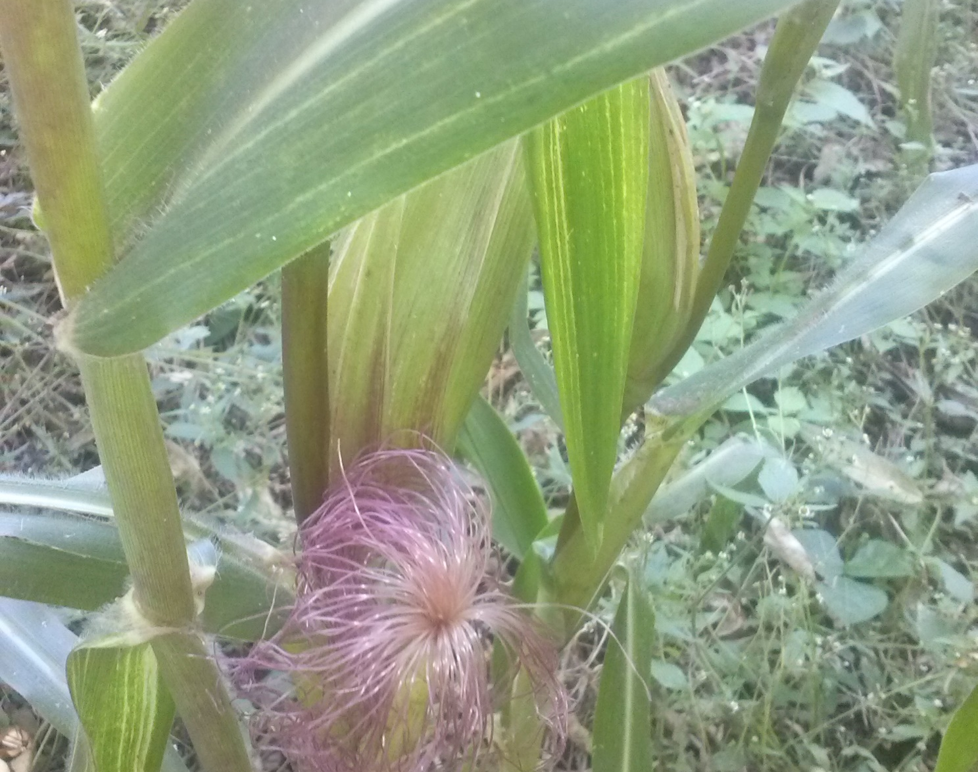
Corn/maize plant
Kingdom- Plantae
Phylum-Magnoliophyta
Class-Liliopsida
Order-Cyprerales
Family- Pociceae
Genus- Zea
Species-Zea mays
Notes:
The plant was obtained from a corn plantation. This organism represent the whole organism. Zea mays has a inflorescent female to minimize cross pollination. During its life cycle the maize plant includes formation of gametes, diploid cells and seeds.

Slide 9
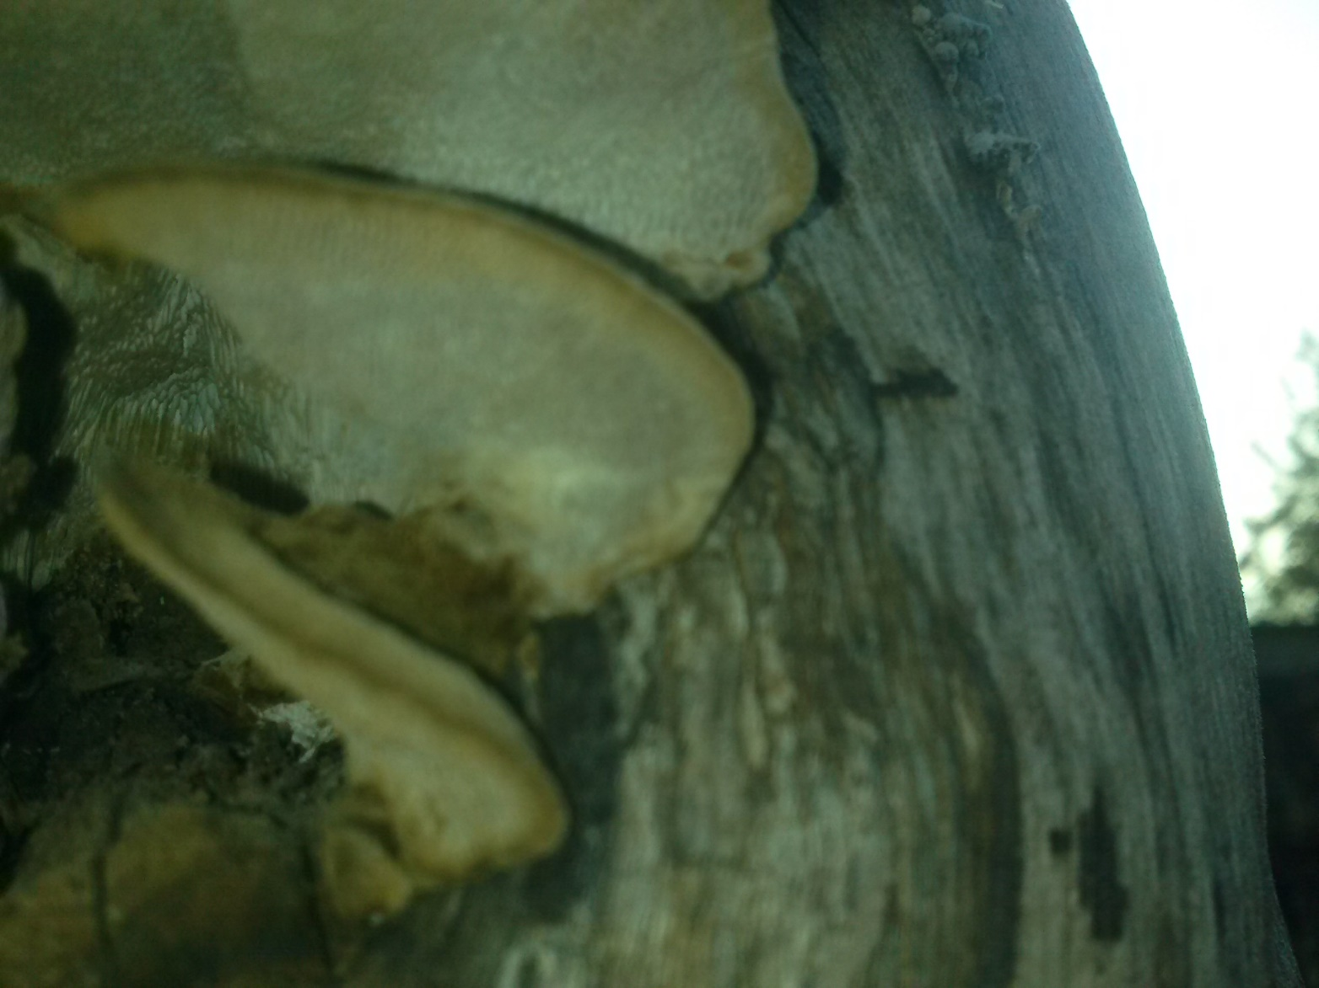
Kingdom-Fungi
Phylum-Basidiomycota
Class- Agaricomycetes
Order- Agaricales
Familiy-Pleurotaceae
Genus-Pleurotus
Species- Pleurotus ostreatus
Notes:
The fungi was grows on wood in large cluster the picture represents the adult organism. In addition it grows on both living trees and dead logs. The fungi is saprophytic and kill and attacks nematodes and bacteria, reproduction is by formation of spores. It is commonly known as oyster mushroom.

Slide 10
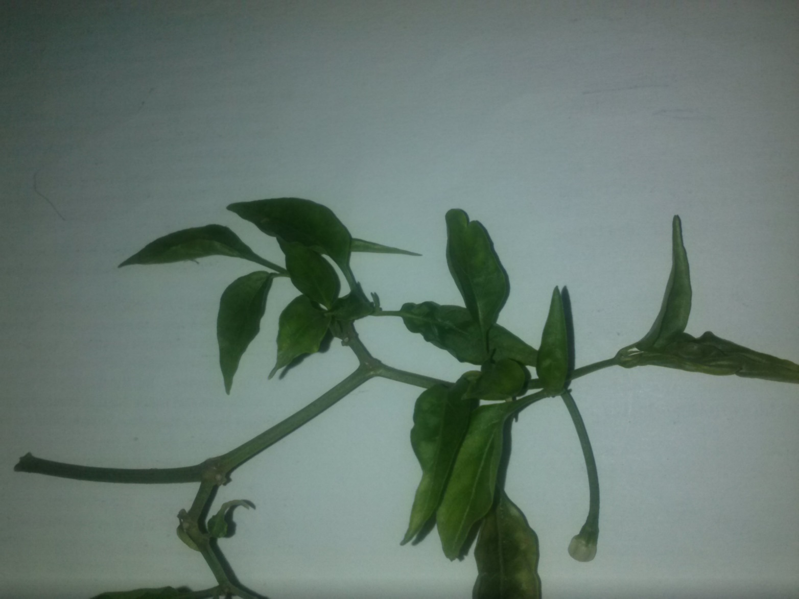
Cayenne chilli
Kingdom- Plantae
Phylum-Spermatophyta
Class- Dicotyledonae
Order-Solanales
Family- Solanaceae
Genus- Capsicum
Species- Capsicum frutescen
Notes:
The sample represent the stem and leaves of capsicum of an adult plant. The plant produces a gametophyte generation, seeds. The green leaves contain chlorophyll that aid in absorption of solar energy.

Slide 11
Animalia
Crucuta Crucuta
Plantae
Kingdom
Phylum/DIVISION
Capsicum
Cypraea Tigris
Spheciospongia
Lumbricus terrestris
Zea mays
Fungi
Chordata
Arthropoda
Mammalia
Carnivore
Crocuta
Hyaenidae
Penaeus
Penaeiodea
Decapoda
Molacostraca
Class
Penaeus
Echinodermata
r
Oreasteridae
Valvatida
Asteroidae
Cypraea
Cypraeidae
Littorinimorpha
Gastropoda
Mollusca
pantaceraster
Speciospongia
Clionaidae
Hadromerida
Demospongiaw
Porifera
Lumbricus
Lumbticidae
Haplotaxida
Oligochaete
Annelida
Capsicum
Solanaceae
Solanales
Dicotyledonae
Spermatophyta
Zea
Pociceae
Cyprerales
Liliopsida
Magnoliophta
Aloe
Xanthorrhoeacea
Aspciragales
Magnoliopsida
Tracheophyta
Pleurotus
Pleurotaceae
Agaricales
Agaricomycetes
Basidiomycetes
Order
Family
Genus
Species

Slide 12
Animalia
Crucuta Crucuta
Plantae
Kingdom
Phylum/DIVISION
Capsicum
Cypraea Tigris
Lumbricus terrestris
Zea mays
Fungi
Jacksonii
Chordata
Arthropoda
Mammalia
Carnivore
Crocuta
Hyaenidae
Penaeus
Penaeiodea
Decapoda
Molacostraca
Class
Penaeus
Echinodermata
r
Oreasteridae
Valvatida
Asteroidae
Cypraea
Cypraeidae
Littorinimorpha
Gastropoda
Mollusca
pantaceraster
Speciospongia
Clionaidae
Hadromerida
Demospongiaw
Porifera
Lumbricus
Lumbticidae
Haplotaxida
Anthozi
Capsicum
Solanaceae
Solanales
Dicotyledonae
Spermatophyta
Zea
Pociceae
Cyprerales
Liliopsida
Magnoliophta
Aloe
Xanthorrhoeacea
Aspciragales
Magnoliopsida
Tracheophyta
Amanitas
Agaricales
Agaricomycetes
Basidiomycetes
Order
Family
Genus
Species
Spheciospongia
Cnidaria
Amanitacea

